Slide 1


Slide 2


Our Team Members
Saumili Dutta
BSWD - 21 - VII - 037
Bistirna Shil
BSWD - 21 - VII - 036
Srinjon Bhattacharjee
BSWD - 21 - VII - 015
Monalisa Roy
BSWD - 21 - VII - 029
Under the guidance of Prof. Madhurima Khan

Slide 3

Problem Statement
Make a system which can provide users with seamless access to a vast library of music, allowing them to discover, stream, and curate playlists effortlessly

Slide 4
Solution
To address the problem statement, we have developed a music streaming web application that leverages high-quality audio streaming. It implements a robust, intuitive user interface for effortless navigation and playlist curation.

Slide 5
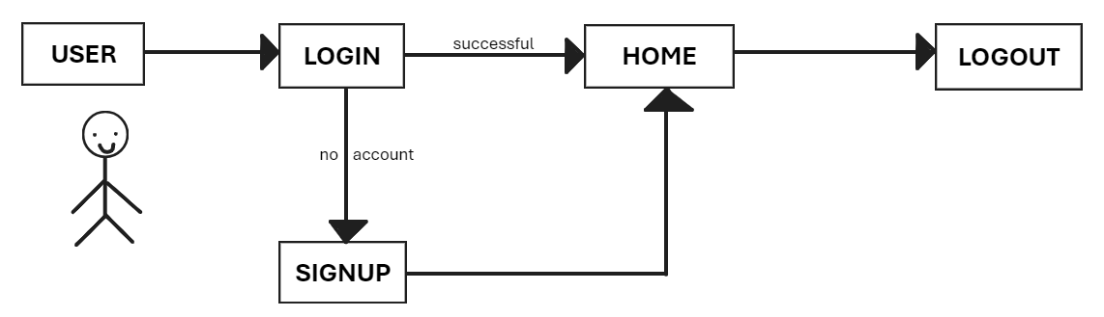
Graphical Abstract

Slide 6
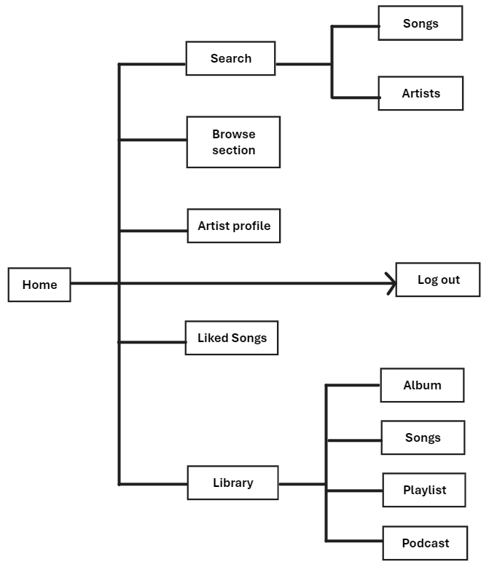
HOME PAGE

Slide 7
SCREENSHOT OF THE PROJECT

Slide 8
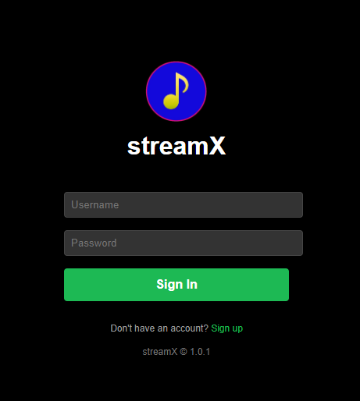

Slide 9
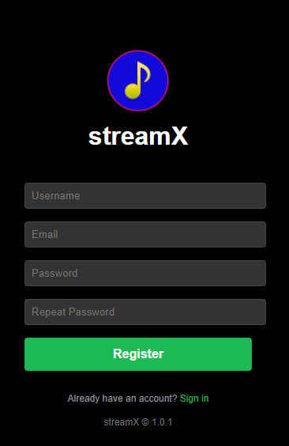

Slide 10
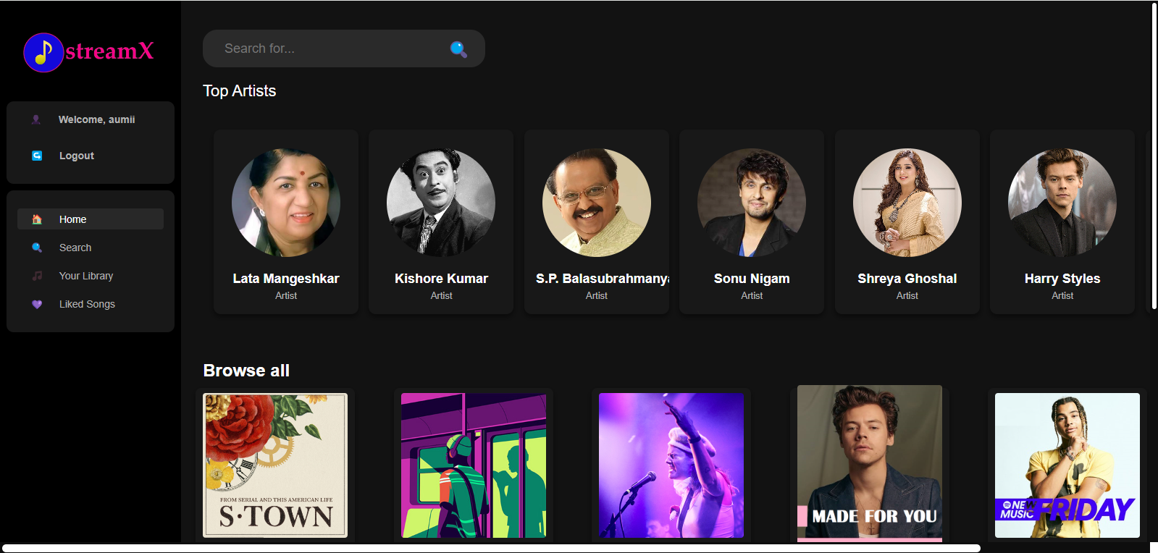

Slide 11
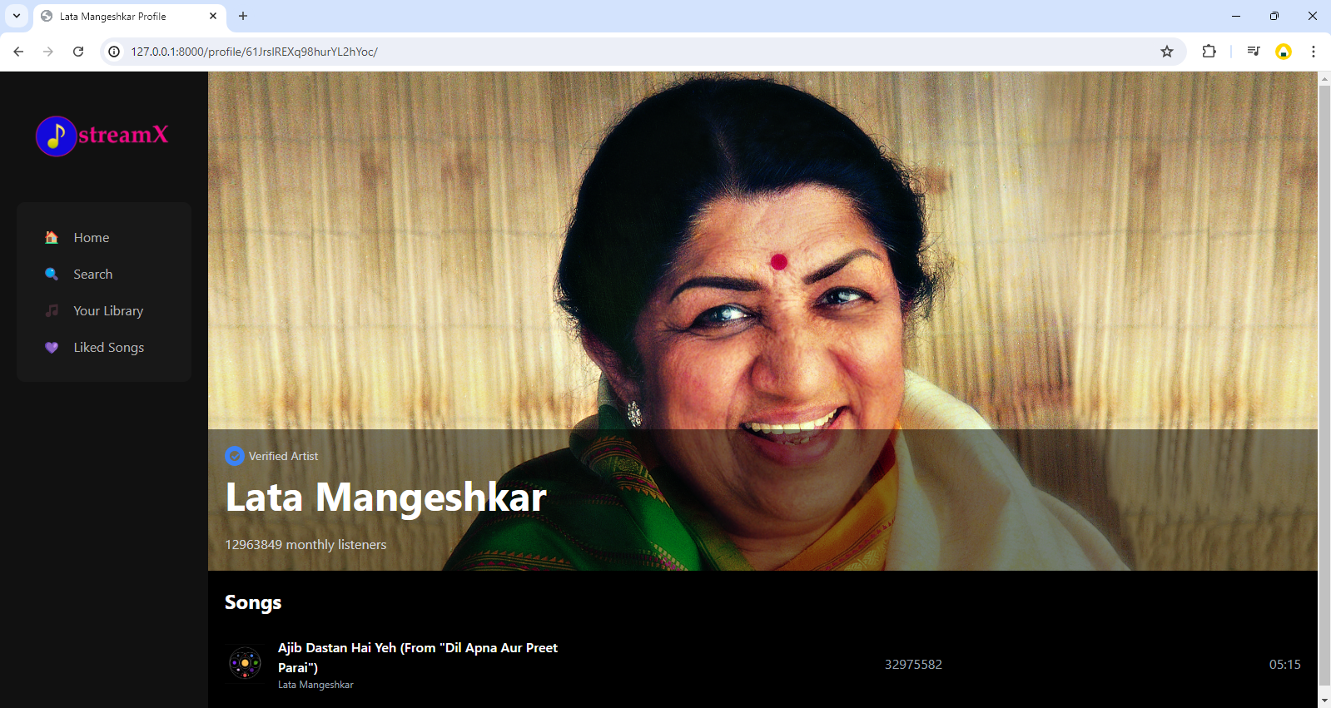

Slide 12
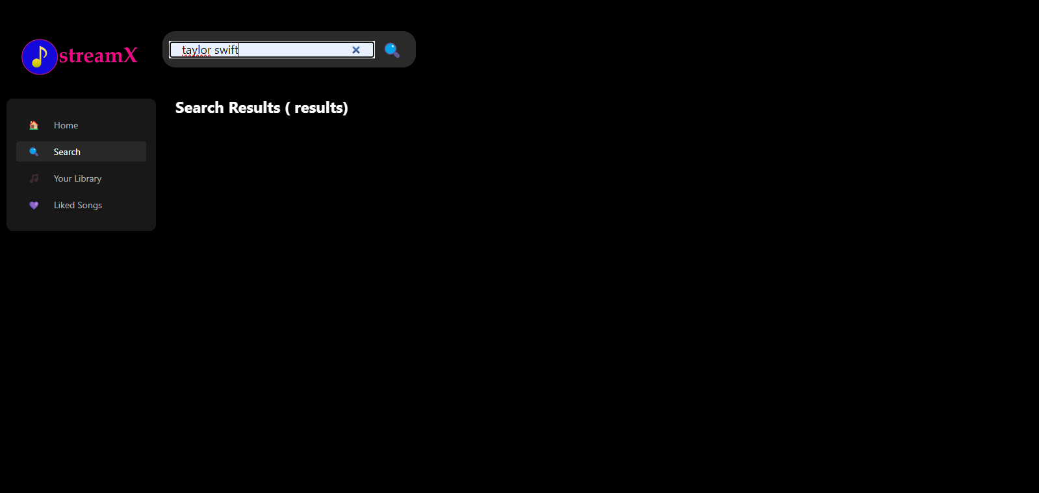

Slide 13
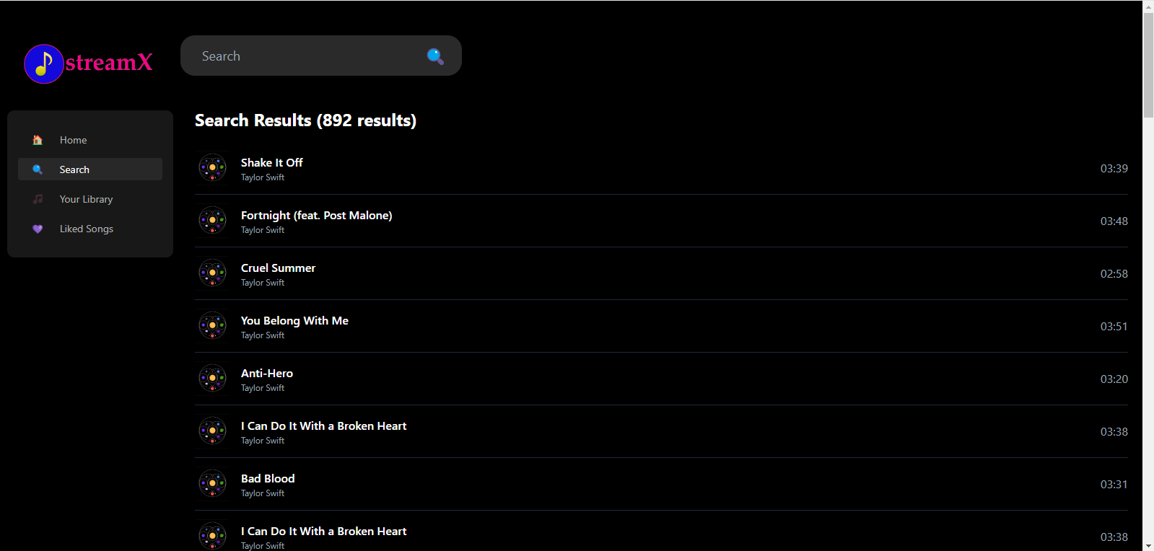

Slide 14
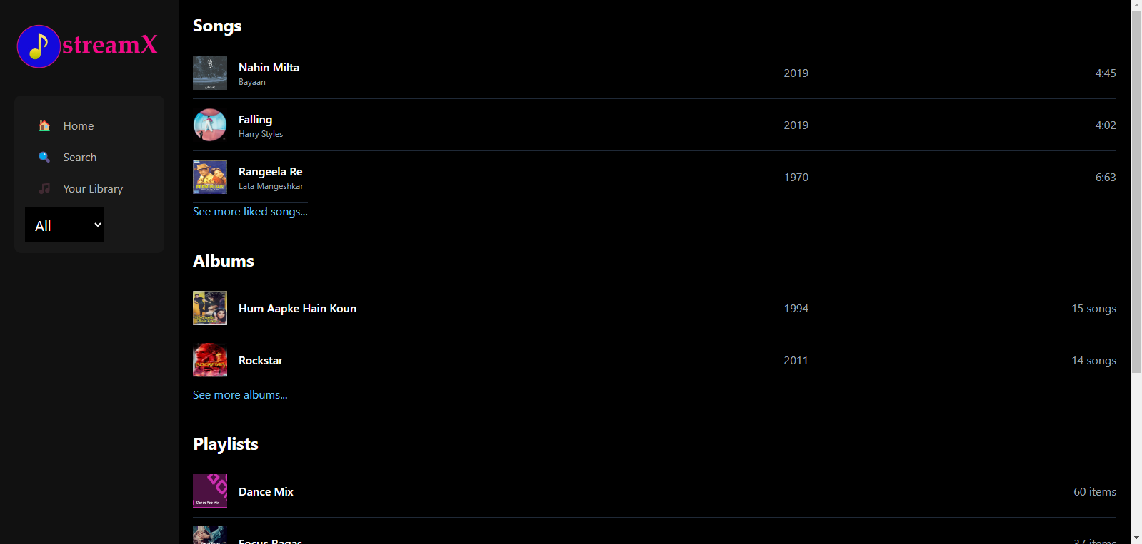

Slide 15
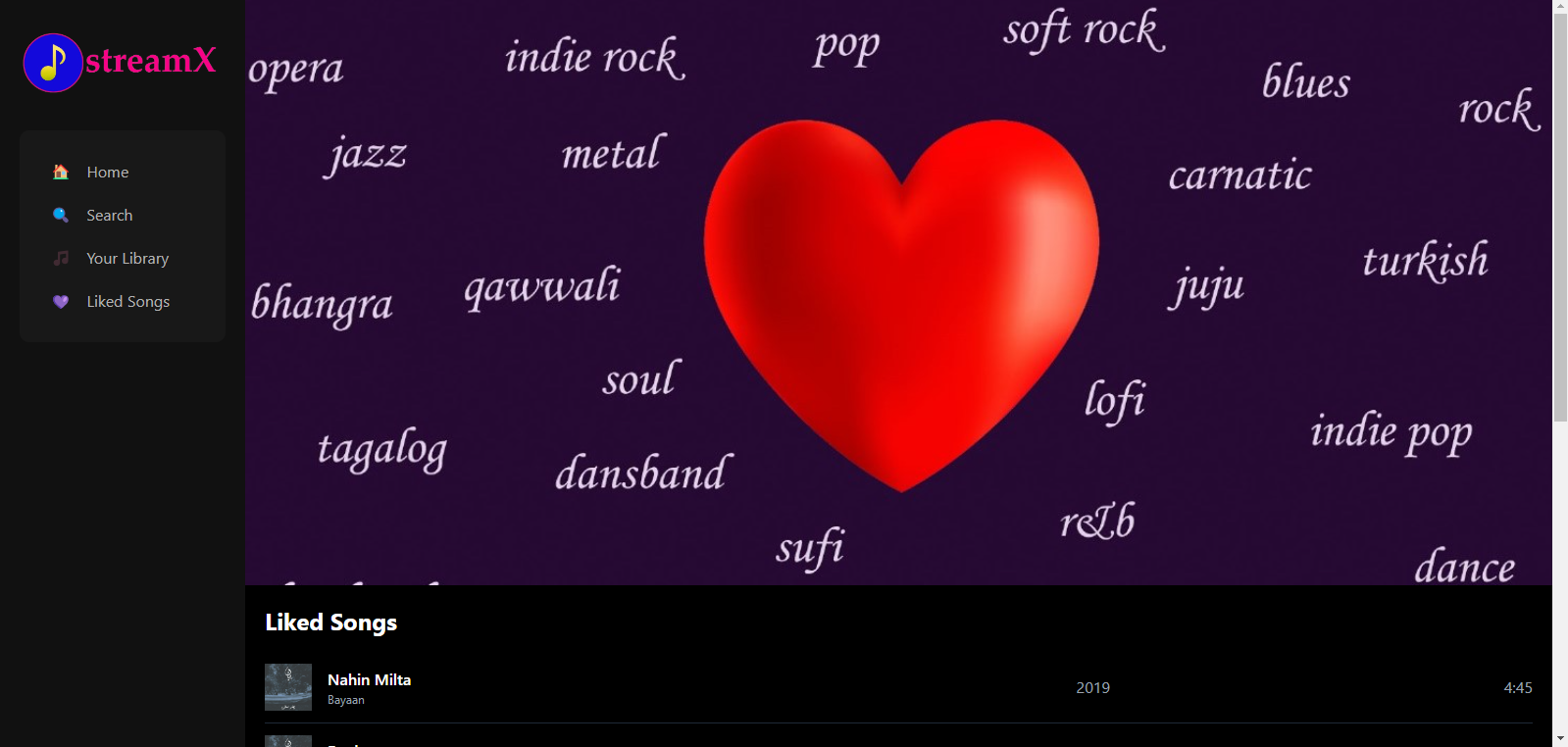

Slide 16
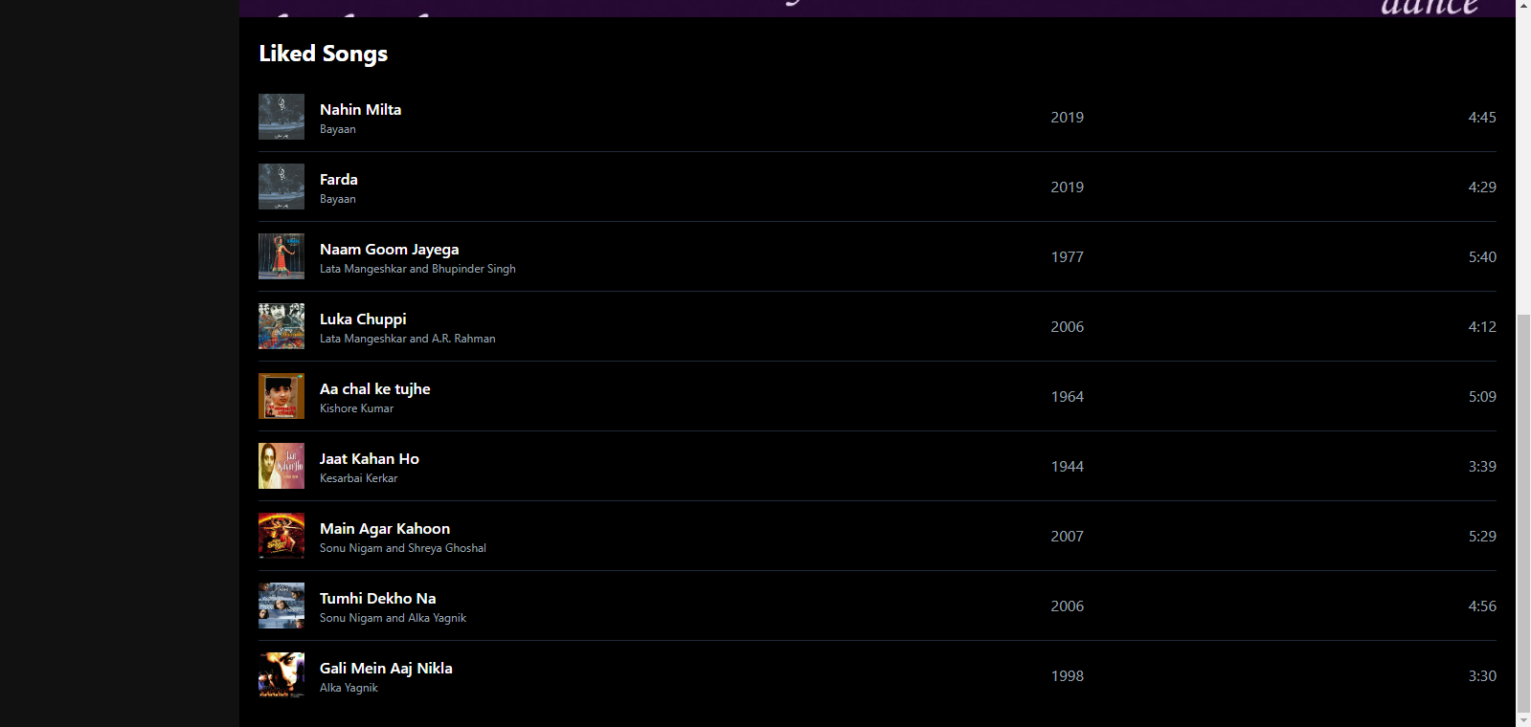

Slide 17
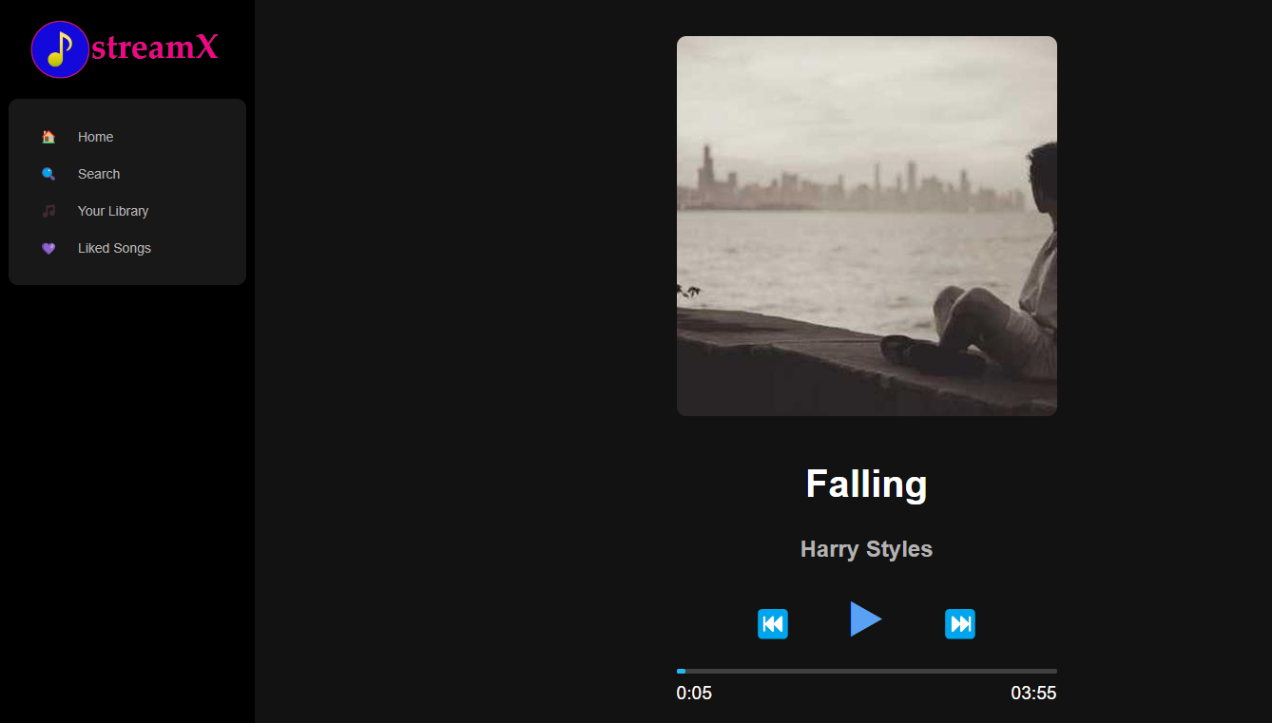

Slide 18
Demonstration
https://127.0.0.1:8000/

Slide 19
Project Summary
The music streaming application is designed to revolutionize the way users interact with and consume music online. This project aims to provide a seamless, high-quality music streaming experience accessible via web browsers. Users can explore a vast library of songs, view playlists, and like it to store in the library. The application combines robust backend services, and an intuitive frontend interface to deliver a user-friendly and engaging experience.

Slide 20
Future Work
There are a lot improvements we want to make in the projects as part of future work.
API to fetch the top artists
Add a button to create playlists by user and sharing option with friends and family
Algorithms to get more personalised recommendations.
Audio input integration to identify the song based on humming by an user
Deploying the application
We want to do a more extensive research to make these work and make this application different
from other existing music streaming applications.

Slide 21
Acknowledgement
I would like to extend my sincere gratitude to my project guides, Prof. Beauty Sarkar for their continuous support and guidance. I also thank my team members for their dedication and hard work. Additionally, I acknowledge the support from Asutosh College for providing the necessary resources.

Slide 22
Bibliography
HTML and CSS: https://youtu.be/G3e-cpL7ofc?si=vKIkJ1JqCD-OlwLE
Python: https://youtu.be/kqtD5dpn9C8?si=ufQR8pb8jesVI5Le
SQL: https://youtu.be/7S_tz1z_5bA?si=GtJ80meQUN2k3b7q
Learning API: Postman Student Expert program
Django installation: https://www.youtube.com/watch?v=weAUmhABjBc
Database connection: https://www.youtube.com/watch?v=IEonn27cUfo
Adding static files: https://docs.djangoproject.com/en/5.0/howto/static-files/

Slide 23
Thank
you

